Slide 1
Adobe DC

Slide 2
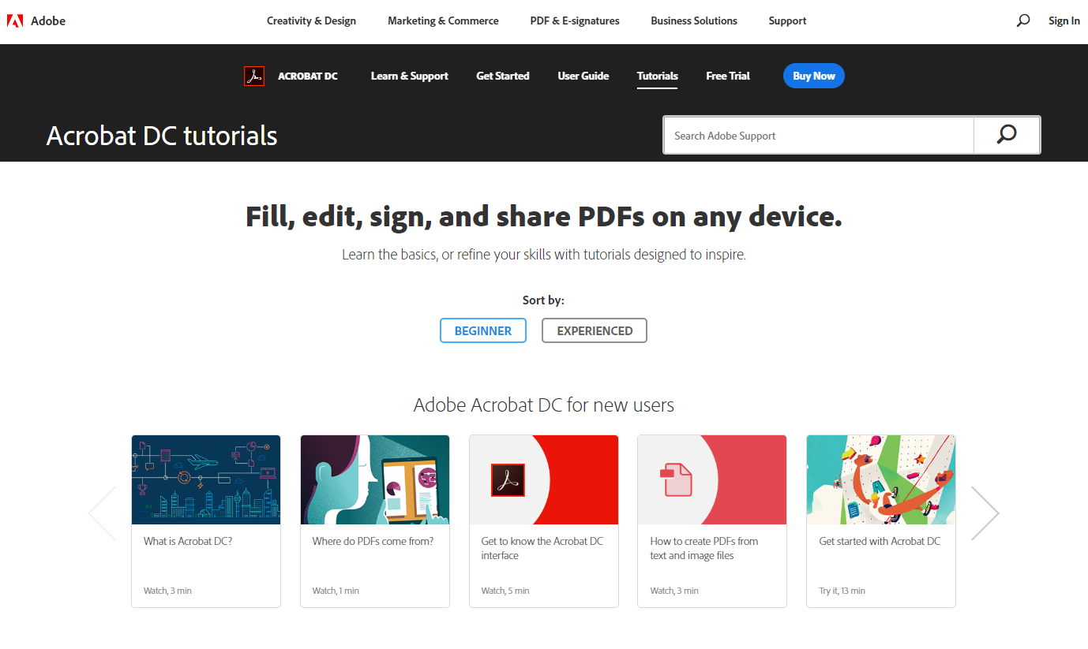
Where to find help
Adobe has tutorials online for learning how to use adobe dc

Slide 3
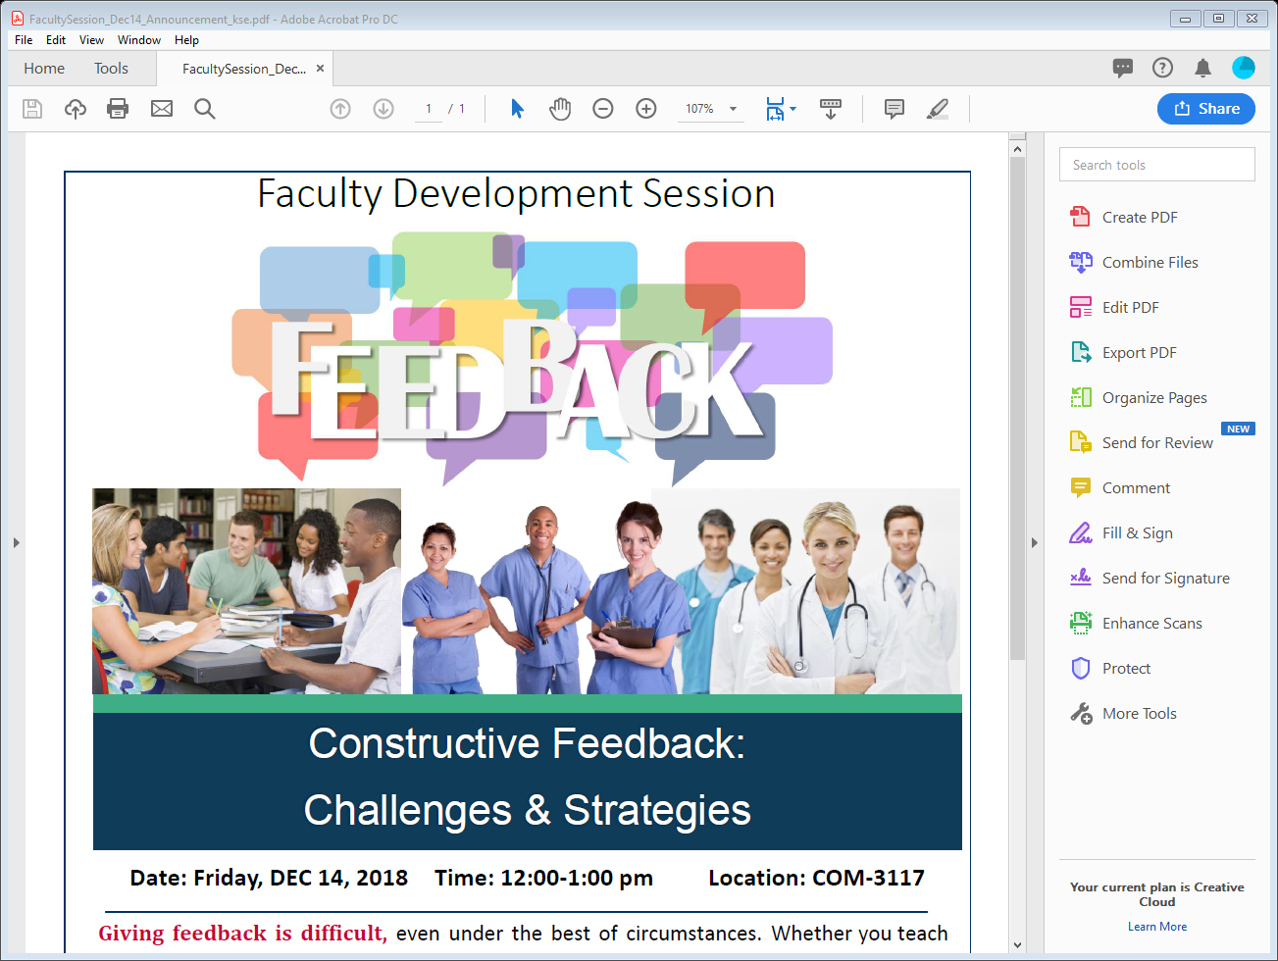
Tool sets
Create PDF & COMBINE FILES
EDIT
EXPORT PDF
ORGANIZE PAGES
SEND FOR REVIEW & COMMENT
PROTECT
Change existing PDF content or layout
Create new files from blank pages, existing files or combination of files
Export to other applications:
Rearrange order of or rotate pages, insert blank pages:
Collaborate with others
SEND FOR SIGNATURE, FILL & SIGN
Obtain signatures
ENHANCE SCANS
Enhance quality of scanned documents:
Create permissions for access to document or document settings

Slide 4
Why use adobe dc as an editing tool?
Numbering pages
footers/headers
Altering the layout
Adding hyperlinks to websites
Substituting graphics, diagrams or other images
Editing the text – Especially helpful when we no longer have access to the original word document
Notes:
Sometimes getting this to work in Word can be an issue, especially when we have lots of special formatting. So we can save these tasks for Adobe DC

Slide 5
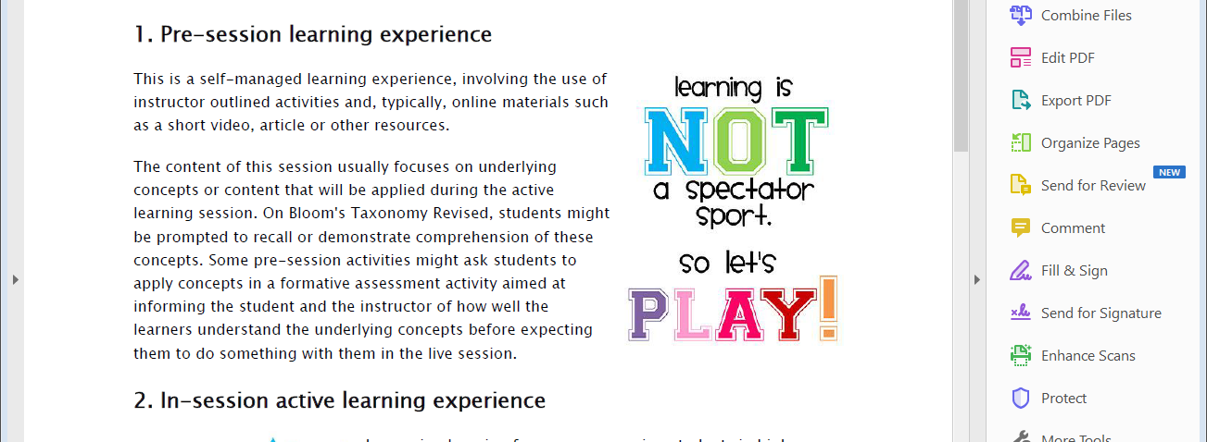
Let’s practice!
Go to FID.medicine.arizona.edu

